Slide 1
NEW9310
Smart POS Terminal
Large Screen Design, Inspiring the Future

Slide 2
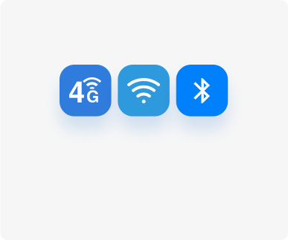
Wireless communication
4G，3G，2G，wifi，BT
6.5 inch HD screen
CPU
Quad-core cortex A53
Double chamber
2MP front 5 MP rear
battery
3.8V/3000mAh

Slide 3
Powerful Performance, Superior Experience
A more powerful Quad-core 1.4G processor makes transactions to run seamless and faster than ever.

Slide 4
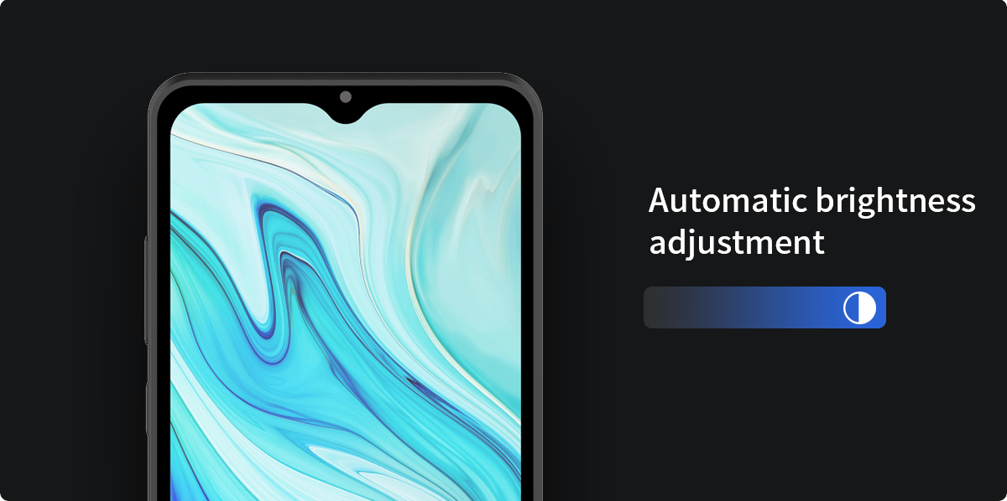
Splendid Large Screen Display
The 6.5-inch touch screen adjusts its brightness based on current lighting conditions and provides you the ultimate visual experience in any environments.

Slide 5
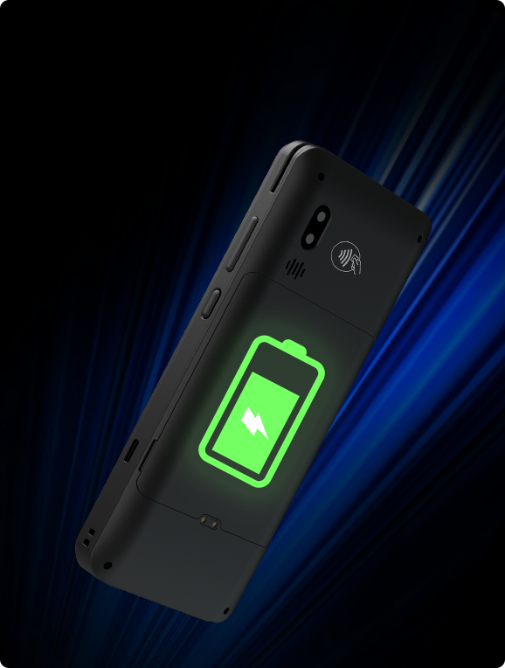
Long Battery Life
The rechargeable 3000mAh/3.8V battery ensures the NEW9310 keeps transacting smoothly a full day with a single charge.

Slide 6
All Solutions For Full Connection
With the help of solutions for full connection, you could make payment or process data rapidly and securely on the spot through: 2G/3G/4G, Wi-Fi，Bluetooth.

Slide 7
Dual Camera
2MP Front camera and 5MP autofocus rear camera catch every detail of the codes, and makes payment more rapid and safer.
200W
500W
Front
Rear

Slide 8
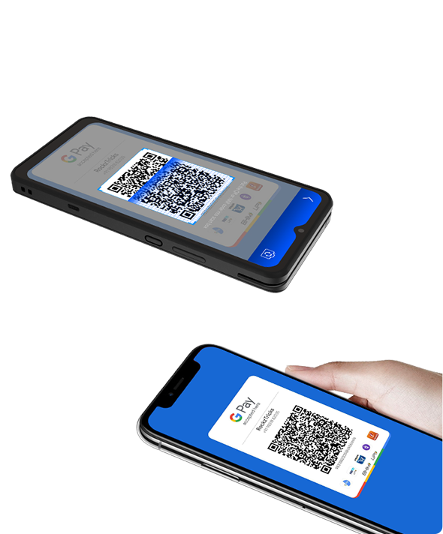
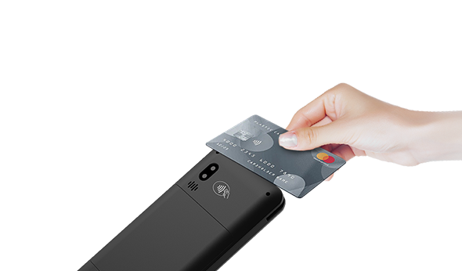
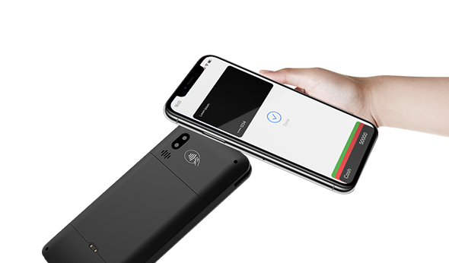
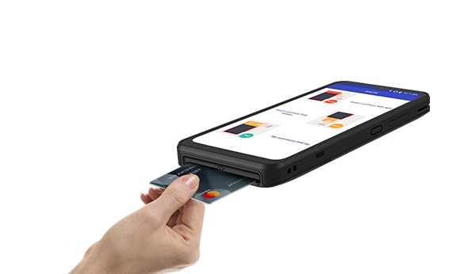
Supporting All Payments
It supports various payment methods, such as magnetic card, IC card, contactless transaction and code scanning transaction. A machine can be used for various forms, making collection simple.
QR Code
Contactless Card
Magnetic Card
NFC
IC Card

Slide 9
Flexible Adaptability
Dining room
Bookstore
Bar
Cafeteria

Slide 10
Specifications
CPU
OS
Memory
Display
Quad-core Cortex A53
Asmart
1GB RAM+8GB ROM
2GB RAM+16GB ROM (optional)
6.5"HD
720 x1600 Pixels
Card Reader
Communication
Location
Camera
Magnetic Card Reader
Smart Card Reader
Contactless Card Reader
4G，WiFi，GPS，Bluetooth
GPS/BEIDOU/GLONASS
Front: 2 MP (optional)
Rear: 5 MP (optional)
Reads 1D & 2D Codes
Peripheral Ports
Card Slots
Battery
Power
1xType-C USB
2xSIM +1xSAM
2xSIM +2xSAM (optional)
Rechargeable Li-ion Battery 3.8V/3000mAh
Input:100-240VAC,50/60Hz
Output: 5VDC,1A
Working environment
Storage environment
Dimensions
Certifications
Temperature:
0°C~50°C(32°F~122F)
Humidity:
10%~90%(non-condense)
Temperature:
-20°C~60°C(-4F~140°F)
Humidity:
5%~95%(non-condense)
LxWxH(mm):
167.5x76.5x16.8
PCI PTS 6X.,EMVL1&L2,EMV CLL1, quick pass, TQM,CE.RoHS.Visa PavWave.MasterCard PavPass

